Slide 1

27 May ‘14
Walk-thru Notes

Slide 2
Inventory Control
Arrived at dock on 1030 ferry with Chef. Loaded 30-35 piece produce order into Suburban and drove to back door of kitchen. No Receiving Protocol observed.
ie. Food Order Sheet was not cross-referenced with Invoice, therefore no way of knowing if everything that was ordered was received or if restaurant was shorted product
All produce, spices, supplies, etc. were piled inside back door, where it is assumed staff put away at a later time, however many items still in place 30 minutes after arrival, when I walked out the door after initial kitchen/ pool area walk-thru
VERY concerned with integrity of product (spoilage, waste, theft, etc.)
Later in visit asked line cook how new menu item of Cowgirl Ribeye was selling and he casually mentioned that just last week case of 10 arrived, but 4 were missing from the box in walk-in so “Someone likes them!”

Slide 3
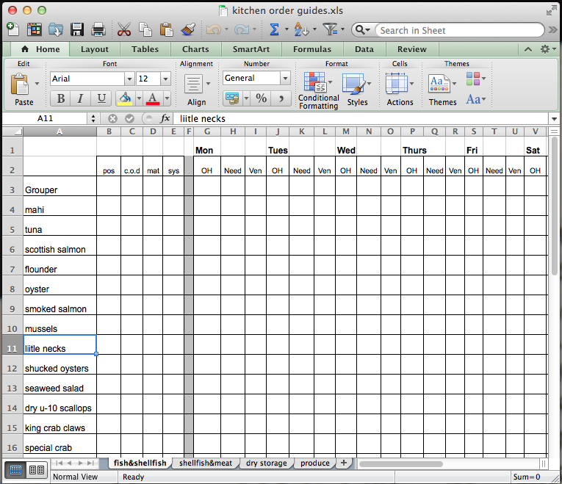
Suggest Kitchen Order Guide
No inventory receiving protocol was observed. Very important that person placing the order make accurate order and leave on clipboard for person receiving order to cross-check deliverables.
Employee theft, waste and variance is not being managed.
Highly recommend that all purchasing and receiving practices are completely overhauled ASAP.

Slide 4
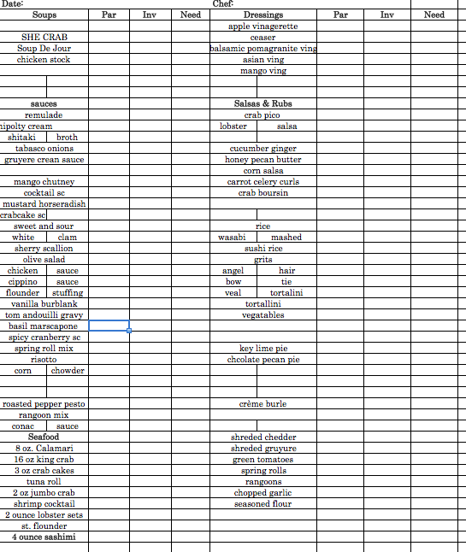
Suggest Daily Prep Sheet
Daily Prep Sheet is vital to ensure all BOH teammates are working together to set each other up for success and over-ordering is limited.
Currently, prep is being written on yellow legal pad.
Suggest daily menu mix be imputed to ensure:
items that need to be prepped are not missed; and
allows chef to delegate more menial tasks to hourly staff

Slide 5
Guest Service
Arrived in dining room for lunch @105 pm. Observed female bartender conversing with two female guests. While she was walking guests through drink menu, the bartender did not raise her head from conversation and acknowledge new guests walking into dining room.
No other FOH staff in view. Guests waited at host stand for 30-45 seconds then wandered thru dining room, taking 4-top table for 3 guests by window overlooking the pool.
Menu’s were not pre-set on tables or readily stacked at host stand. Neither bartender or FOH staff came to table to greet us until 119pm, 14 minutes after arrival.
Female bartender approached table without menu’s, did not apologize for tardiness, asked gruffly if we wanted a drink, we said yes, asking to see a menu, she then left our table and brought menu’s to table.

Slide 6
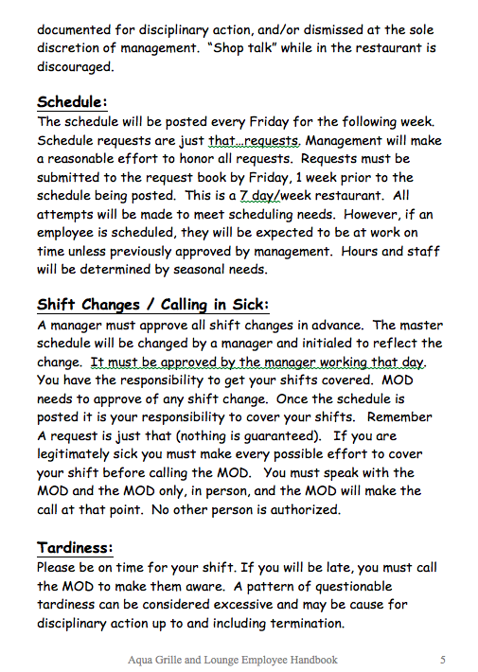
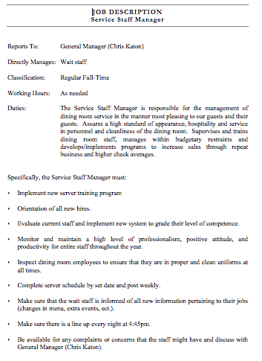
Employee Job Description / Employee Handbook

Slide 7
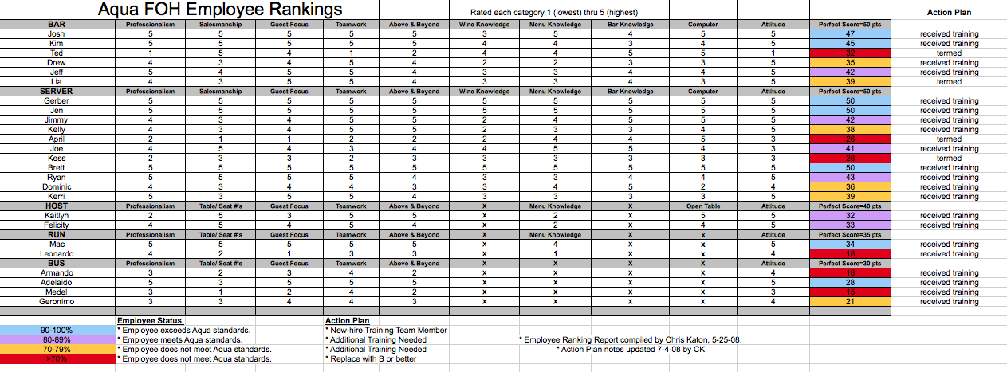
Employee Ranking with Training Action Plan

Slide 8
Staff Training
Observed Asst Manager Wes working with four new FOH service staff taking tables around pool area. One waitress, working first day; one waitress, one server working second day; being trained by server working about three weeks.
Wes also taking tables, orders, food running to 18 guests outside in pool area.
Bartender took our table and adjacent table, where Salesman Ryan was trying to pitch property to husband and wife considering move to island.
Bartender did not engage table, nor did Chef or Asst Manager acknowledge guests. Restaurant seemed severely overstaffed for volume of business observed

Slide 9
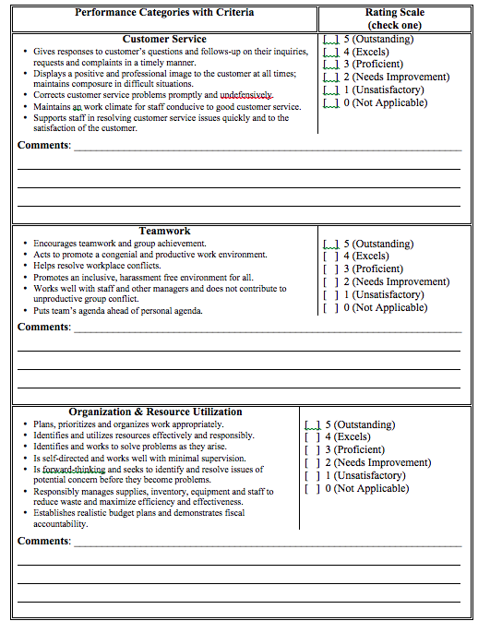
Performance Review
Set expectations in order to manage the “Don’t Know”, then hold staff and management team accountable with regular review process.
Believe all staff must start from scratch to learn “Basic’s of Service.”
Observed horrific guest awareness and non-existent new-hire employee training program.

Slide 10
Salesmanship
Bartender brought two waters to table. Female companion ordered mimosa, I ordered draft beer. Only after drinks were served was drink menu mentioned.
No attempt at suggestive selling observed. No specials featured or mention of “Chef’s New Menu”
Female companion ordered “Flatbread of the Day” – bartender could not tell us ingredients that contained and did not check with kitchen and report back to table

Slide 11
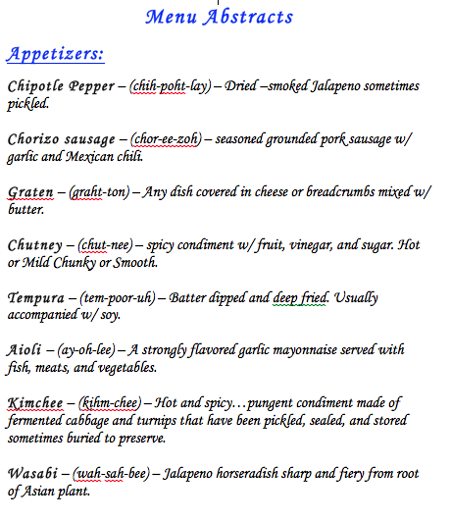
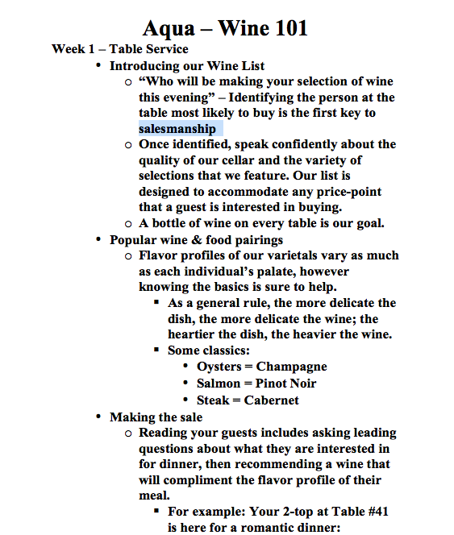
Menu Item Descriptions / Sample Wine Training

Slide 12
Food Quality
Chef hand-delivered food to only other table in restaurant and our table, so no real opportunity to observe staff in action. Chef noticed balsamic glaze garnish missing from Fried Greet Tomato Salad and fixed after bringing soup and flatbread to table
Asked Chef ingredients of Flatbread of the Day to learn roasted roma tomato, chicken, sweet onion, and fig. Looked and smelled delicious. Would have ordered as my lunch had I known what was being served.
Confident that Chef Larry will continue to execute delicious menu items and consistency will continue to improve if Management Systems are implemented and he’s given time to focus on staff training, labor control

Slide 13
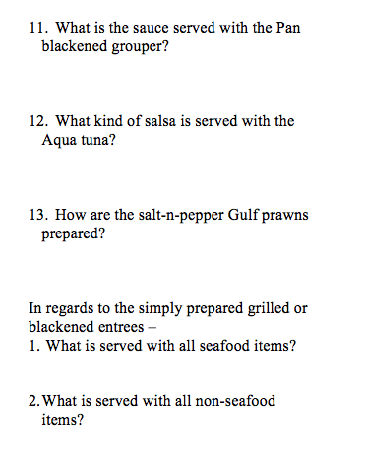
Daily Pre-Meal Meeting
Recommending Daily Pre-Meal Meeting with Chef and All FOH/BOH staff in attendance. Best opportunity to communicate all new information ask/answer staff questions.
To be held prior to every shift.
Believe this is the most important 15 minutes of the day!
Staff should roll-play menu item featuring and daily special descriptions until detailed verbage is part of every special presentation.

Slide 14
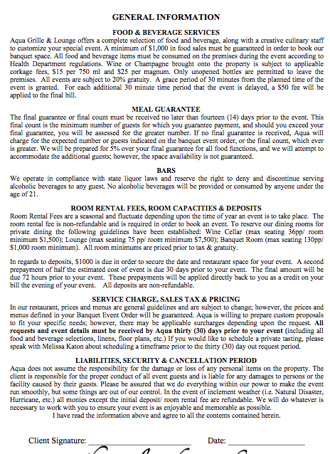
Banquets and Special Events
Sample Banquet Menu Agreement to be used for all catering functions.
Guest to pre-select menu package to be approved by chef and FOH management team.
Weekly Action Item during Management Meetings to talk-thru upcoming functions / banquets.
Sample items to be discussed include dining room set-up, special requests, staffing needs, etc.
Recommend all parties pre-set night prior to event to set restaurant up for success.

Slide 15
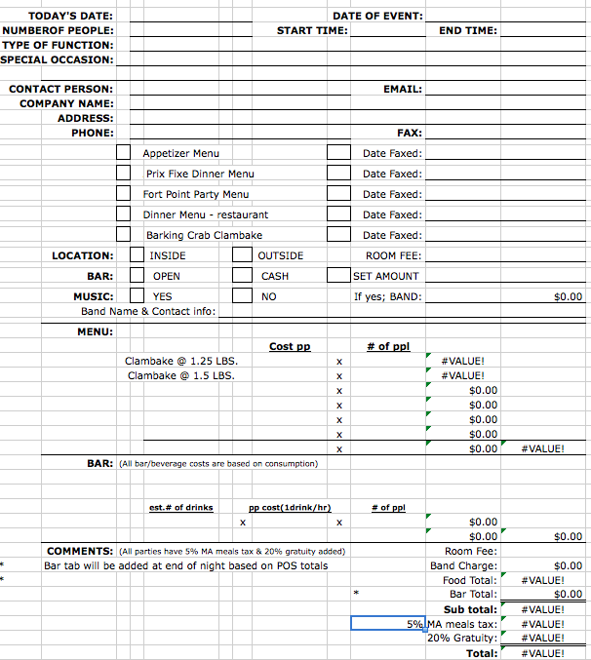
Event Proposal Form
It’s important to remember that Banquets, Weddings, Holiday Parties and other Special Events should generate increased revenue and guaranteed cash flow to offset ups and downs of regular business.
As a result, each must be managed properly to ensure that the property is maximizing its return on investment, therefore proper budgeting and planning must occur.

Slide 16
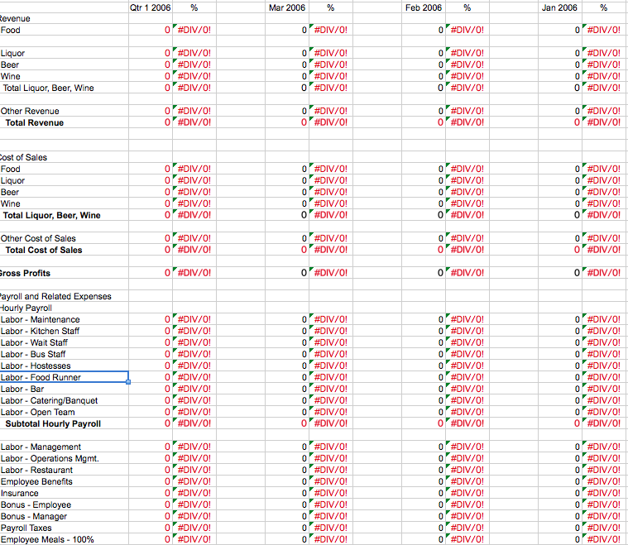
Profit & Loss
A detailed line item budget with serviceable reports from a reliable POS System is integral in operating a profitable business and ensuring that theft and mismanagement of controllable expenses are being managed properly.
I operate on the philosophy that Prior Planning Prevents Piss Poor Performance. As such, an agreed upon declining budget to manage controllable expenses will be important to achieve maximum success.

Slide 17
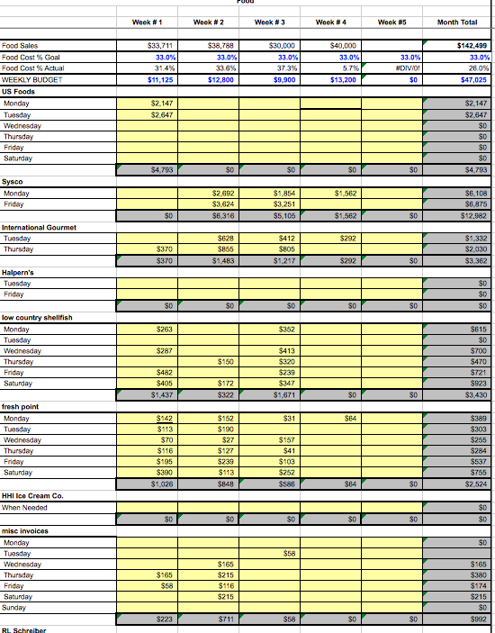
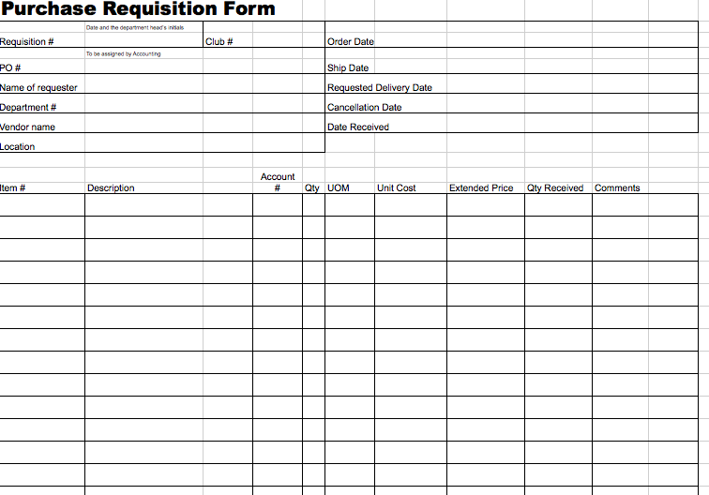
Purchase Control Sheets

Slide 18
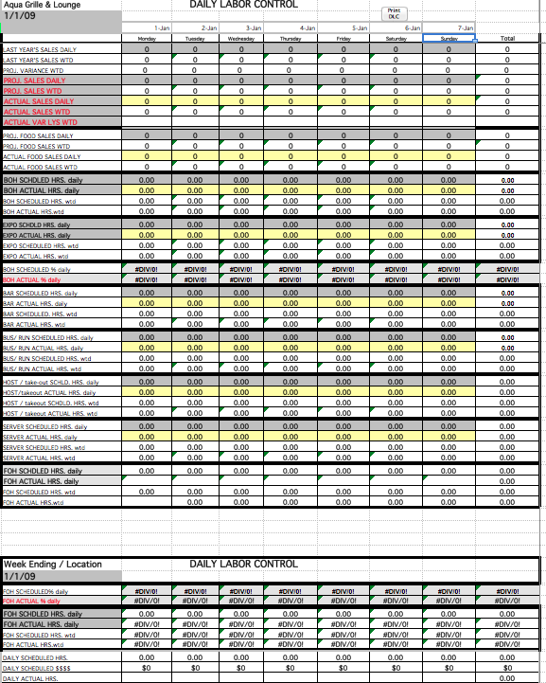
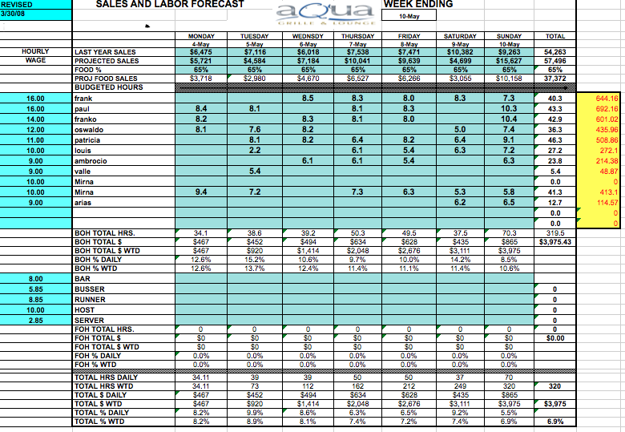
Daily Labor Control

Slide 19
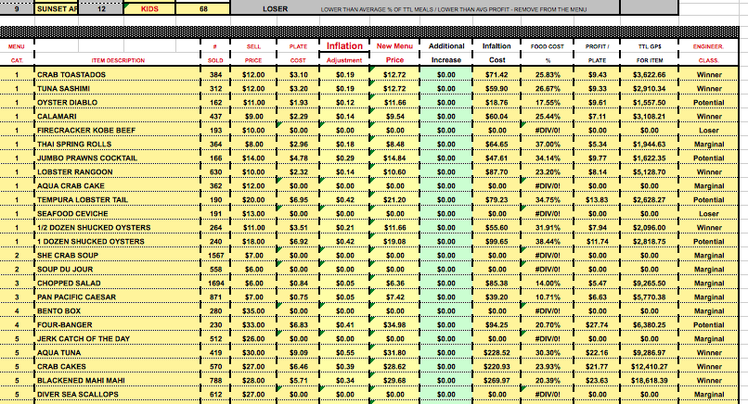
Menu Profitability Analysis

Slide 20
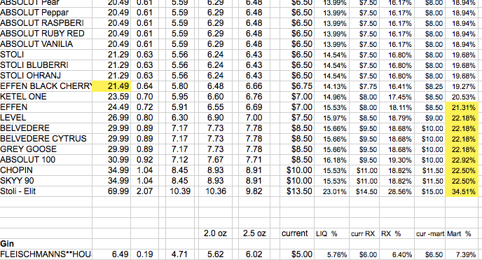
Liquor / Beer / Wine Profitability Analysis

Slide 21
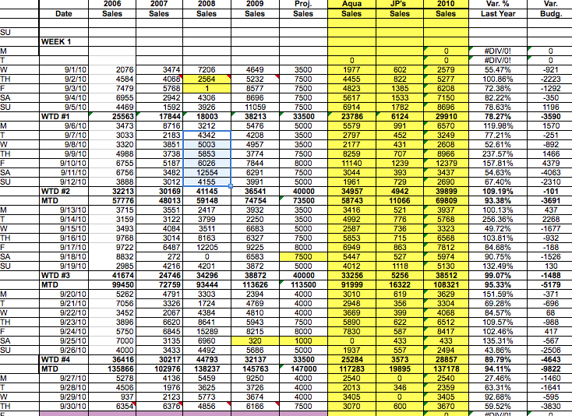
Daily Sales Tracking

Slide 22
Thank you again for your time and consideration. I will look forward to speaking with you again soon. Until then, all my best!
Chris Katon

